Slide 1
The Americas
HOW WE GOT HERE

Slide 2
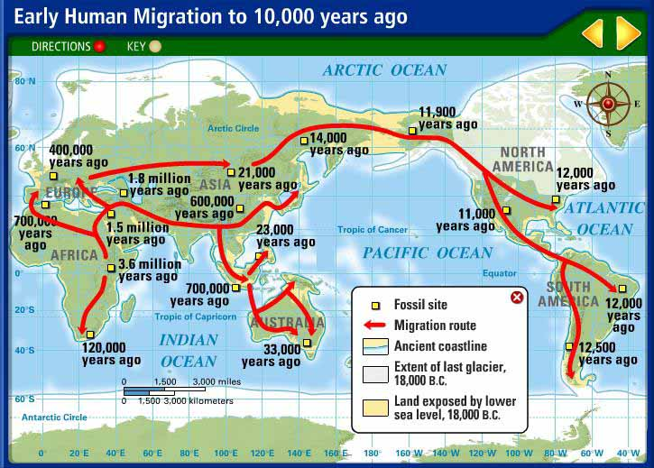
ICE AGE
10,000-100,000 Years ago
Glaciers – thick sheets of ice – covered 1/3 of the Earth

Slide 3
BERINGIA
Bering land bridge – between Siberia and Alaska
1st Americans – nomads chasing food – hunters/gatherers
Spread all over Americas

Slide 4
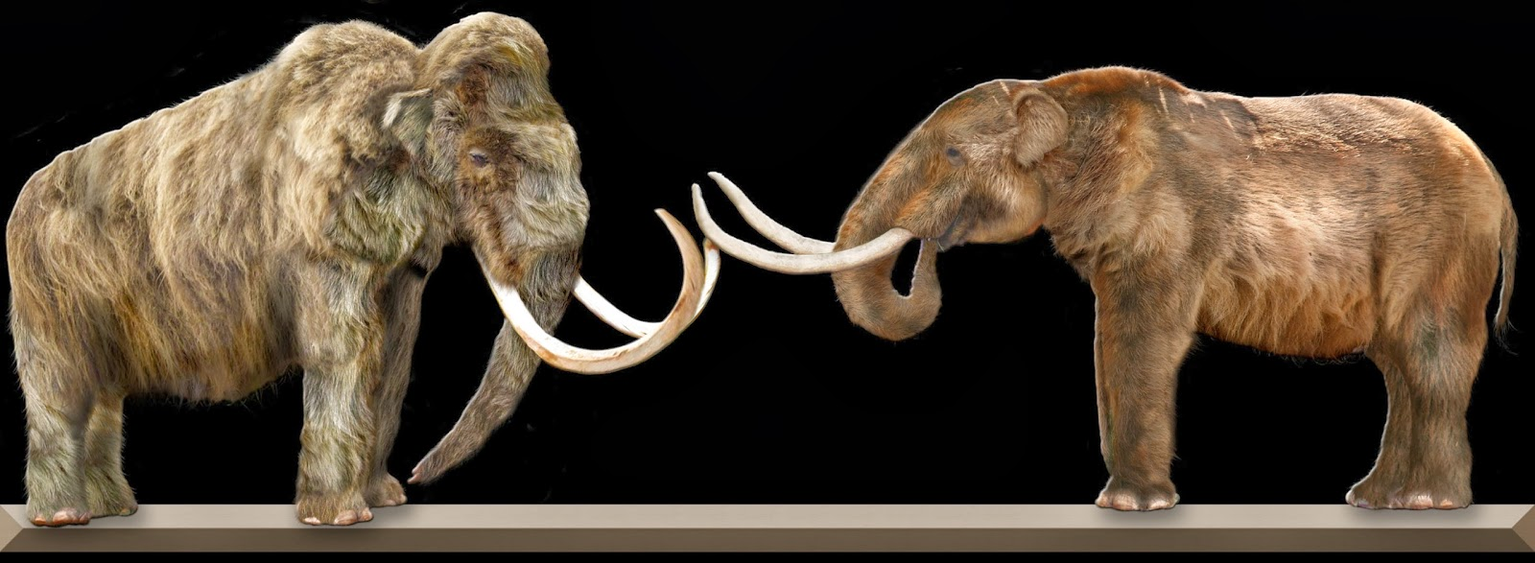
ICE AGE CREATURES
LEGENDS AN WALL PAINTINGS SHOW
MASTODONS
SABER-TOOTHED TIGERS
WOOLY MAMMOTH

Slide 5
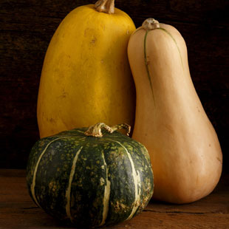
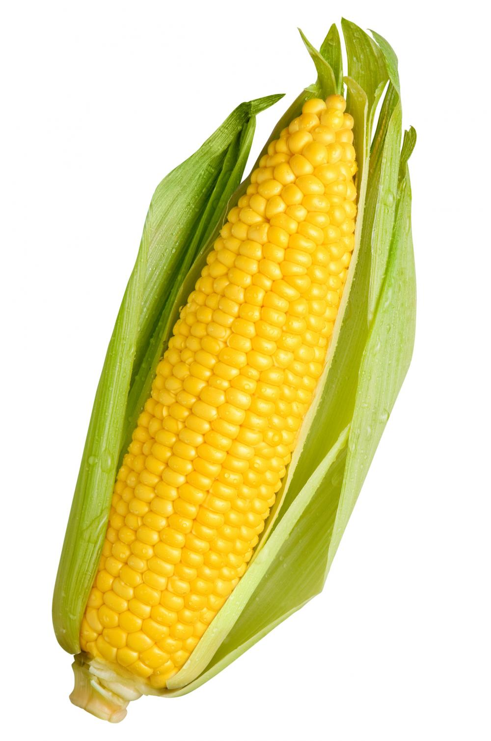
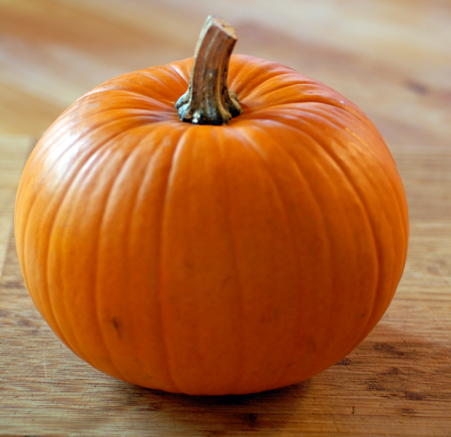
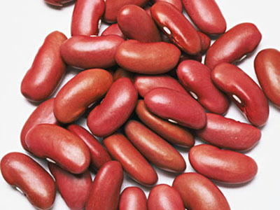
Settlements – small communities development
About 5,000 years ago
People learned to farm = key advancement
Surplus = extra food to support large populations
Maize
Squash
Pumpkins
Beans

Slide 6
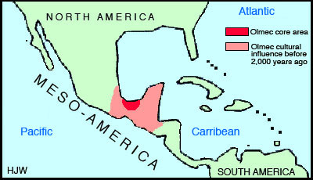
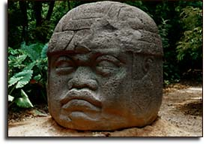
OLMECS
1500 BC- 300 BC
PRESENT-DAY MEXICO, GUATEMALA, HONDURAS
LARGE STONE SCULPTURES (MOSTLY HEADS)

Slide 7
MAYA
300-1100 AD
Rainforests of Honduras, Mexico, Belize, Guatemala
FARMED – maize, sweet potatoes,
May have had 2 million people
Stone step pyramids
Hieroglyphic writing

Slide 8
CHICHEN ITZA major Mayan city
A HUGE CALENDAR
KIND OF LIKE A SUN-DIAL AS WELL
365 STEPS (4 SIDES X 90, 5 AT THE TOP)
MAYA WERE VERY INTERESTED IN ASTRONOMY, MATHEMATICS AND ARCHITECTURE

Slide 9
MAP OF THE CHICHEN ITZA

Slide 10
THE PYRAMID – CALENDAR 90 STEPS ON 4 SIDES – 4 STEPS TO TOP – USE

Slide 11
CHACMOOL – MAYAN GOD PLACED A BEATING HEART ON PLATE

Slide 12
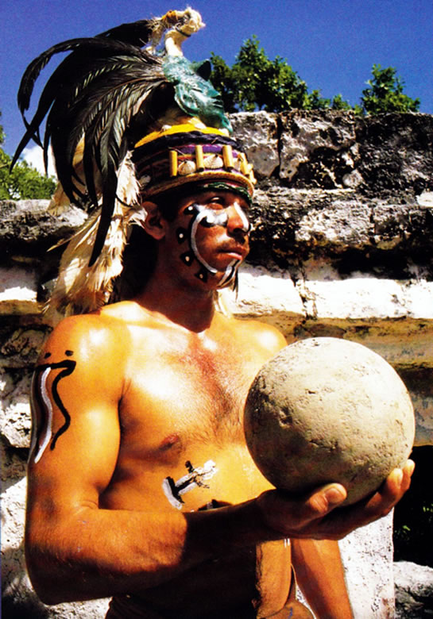
THE BALL COURT

Slide 13
THE GOAL

Slide 14
PYRAMID TODAY

Slide 15
VERY STEEP/ SMALL STEPS

