Slide 1
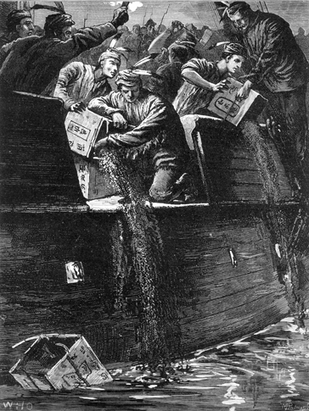
[ 3.3 ] Taking Up Arms

Slide 2
[ 3.3 ] Taking Up Arms
Learning Objectives
Explain how a dispute over tea led to further tension between the colonists and Great Britain.
Describe ways that the British Parliament punished the colonists for the Boston Tea Party.
Explain how fighting broke out in Massachusetts, including battles in Lexington and Concord and Bunker Hill.
Explain actions the First and Second Continental Congress enacted to address the crisis with Britain.
Describe the advantages and disadvantages of Britain and the colonists as the war began.

Slide 3
[ 3.3 ] Taking Up Arms
Key Terms
Tea Act
Boston Tea Party
civil disobedience
Intolerable Acts
Quebec Act
Thomas Jefferson
First Continental Congress
militia
minutemen
battles of Lexington and Concord
Olive Branch Petition
Green Mountain Boys
Continental Army
Patriots
Loyalists
Battle of Bunker Hill
blockade
mercenaries

Slide 4
The Boston Tea Party
The calm between the colonies and England did not last long. Economic and political disputes continued, this time over a simple drink. Tea was tremendously popular in the colonies. By 1770, at least one million Americans brewed tea twice a day. People “would rather go without their dinners than without a dish of tea,” a visitor to the colonies noted.

Slide 5
The Boston Tea Party
Mercantilist Policies Lead to the Tea Act
A Boycott Against Tea
An Act of Civil Disobedience

Slide 6
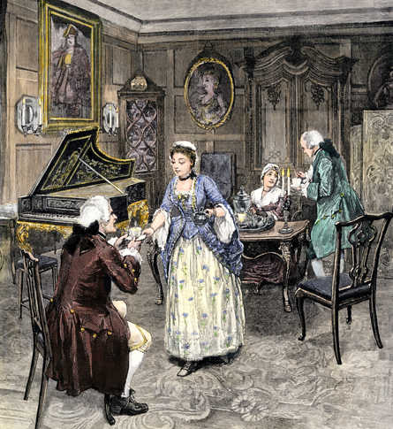
The Boston Tea Party
Many colonists were quite fond of tea. They opposed the Tea Act of 1773 because they did not believe the British had the right to tax them.

Slide 7
King George III Strikes Back at Boston
Colonists had mixed reactions to the Boston Tea Party. Some cheered it as a firm protest against unfair British laws. Others worried that it would encourage lawlessness in the colonies. Even those who condemned the Boston Tea Party, though, were shocked at Britain’s harsh response to it. The unrest in Boston and the British reaction to the Tea Party would be yet another cause of the Revolution.

Slide 8
King George III Strikes Back at Boston
The Intolerable Acts Anger Massachusetts
The Quebec Act Redraws North American Borders
The Intolerable Acts Draw Other Colonies into the Struggle

Slide 9
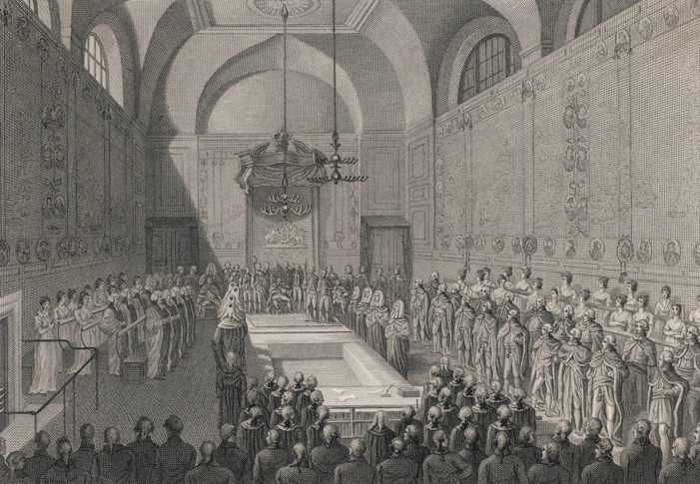
King George III Strikes Back at Boston
In 1774, King George III and the British Parliament passed four laws to punish Massachusetts in response to the Boston Tea Party. These laws became known as the Intolerable Acts.

Slide 10
King George III Strikes Back at Boston
All of these territories were awarded to Quebec as part of the Quebec Act.

Slide 11
The Battles of Lexington and Concord
In Massachusetts, colonists were already preparing to resist. Newspapers called on citizens to prevent what they called “the Massacre of American Liberty.” Volunteers known as minutemen trained regularly. Minutemen got their name because they kept their muskets at hand and were prepared to fight at a minute’s notice. In towns near Boston, minutemen collected weapons and gunpowder. Meanwhile, Britain built up its forces. More troops arrived in Boston, bringing the total number of British soldiers in that city to 4,000.

Slide 12
The Battles of Lexington and Concord
The Redcoats Cross the Charles River
Fighting in Lexington and Concord

Slide 13
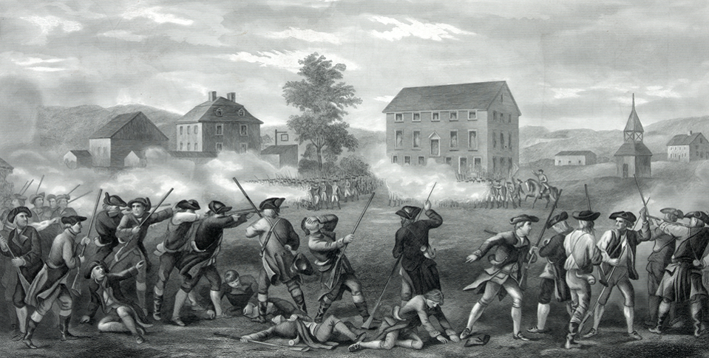
The Battles of Lexington and Concord
Eight colonists were killed in the skirmish between the minutemen and British soldiers at Lexington, Massachusetts, in 1775.

Slide 14
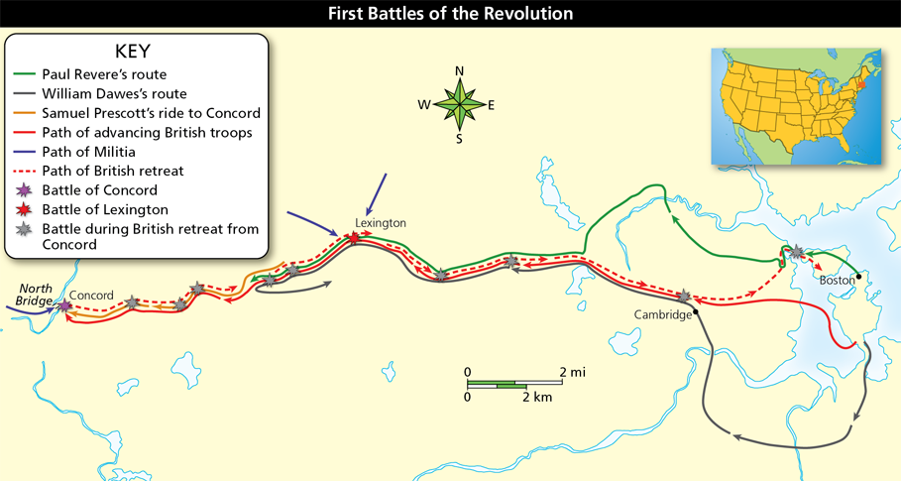
The Battles of Lexington and Concord
Analyze Maps Why were colonial minutemen so prepared for the arrival of the redcoats near Concord?

Slide 15
The Fighting Continues
Just a few weeks after the battles at Lexington and Concord, on May 10, 1775, colonial delegates met at the Second Continental Congress in Philadelphia. The delegates represented the 13 British colonies from New Hampshire to Georgia. Most of the delegates still hoped to avoid a final break with Britain. However, while they were meeting, the fighting spread.

Slide 16
The Fighting Continues
King George III Rejects Peace
Vermont Rebels Gain a Route to Canada
George Washington Takes Command

Slide 17
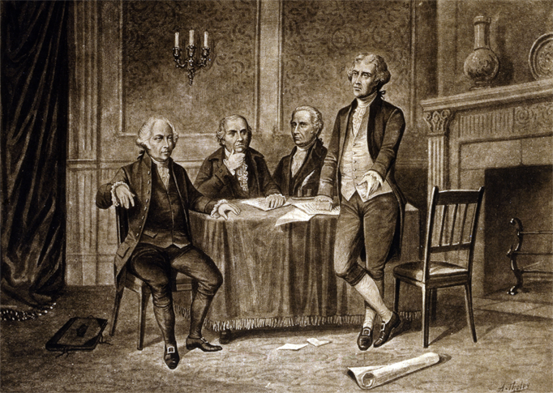
The Fighting Continues
The Second Continental Congress met in the summer of 1775 to discuss how to respond to the British aggression at Lexington and Concord and the failure to rescind the Intolerable Acts.

Slide 18
Opposing Sides at War
The colonists who favored war against Britain called themselves Patriots. They thought British rule was harsh and unjust. About one third of the colonists were Patriots, one third sided with the British, and one third did not take sides.

Slide 19
Opposing Sides at War
Washington Leads the Patriots
British Advantages and Disadvantages
Loyalists Favor the King

Slide 20
Opposing Sides at War
Analyze Charts The Revolutionary War was largely a fight between the colonists and the British. Why was it also a fight between the colonists themselves?

Slide 21
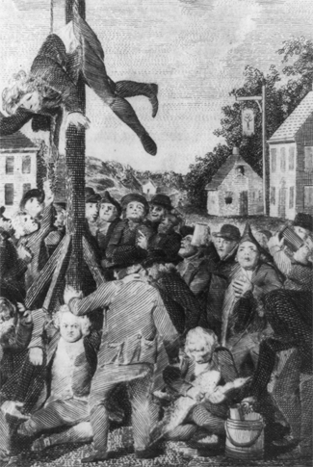
Opposing Sides at War
Loyalists sided with Britain. Many Loyalists were persecuted by Patriots, who favored going to war with Britain. In this engraving, Patriots tar and feather a group of Loyalists.

Slide 22
The War Comes to Boston
During the first year of conflict, much of the fighting centered around Boston. About 6,000 British troops were stationed there. Colonial militia surrounded the city and prevented the British from marching out.

Slide 23
The War Comes to Boston
War Breaks Out Near Boston Harbor
Washington Forces the British out of Boston

Slide 24
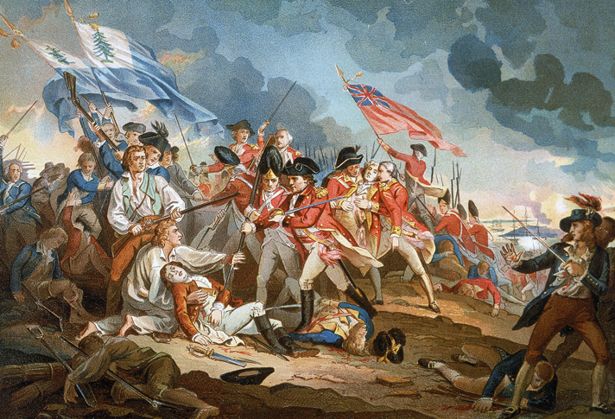
The War Comes to Boston
The Battle of Bunker Hill was the first major conflict of the American Revolution. The British won the battle, but suffered many more casualties than the Americans.

Slide 25
Quiz: The Boston Tea Party
How did Parliament effectively lower the price of tea in the colonies through the Tea Act?
A. It lowered the tax on tea in the colonies.
B. It removed the tax on tea in the colonies.
C. It sold tea directly to consumers.
D. It increased the supply of tea.

Slide 26
Quiz: King George III Strikes Back at Boston
Which was one of the punishments set forth in the Intolerable Acts?
A. Boston Harbor was closed for a week and then reopened.
B. Parliament forbade colonists in Massachusetts from having town meetings without permission from the governor.
C. The Quartering Act was repealed.
D. Those who took part in the Boston Tea Party were put in prison.

Slide 27
Quiz: The Battles of Lexington and Concord
Why did the British march to Concord?
A. They wanted to seize weapons that were stored there.
B. They knew the heights around Concord made it a strategic location.
C. They wanted to show their superior military strength.
D. They were looking for George Washington’s troops.

Slide 28
Quiz: The Fighting Continues
The main purpose of the Olive Branch Petition was an attempt to
A. make King George act reasonably.
B. avoid a break with Britain and potential war.
C. gain time to prepare for war with Britain.
D. show King George that the colonists were unified.

Slide 29
Quiz: Opposing Sides at War
The British were at a disadvantage in the war because
A. their Army was inexperienced in combat.
B. their Navy had little control over colonial ports.
C. their news and supplies had to come from Britain.
D. they had little support amongst colonial Loyalists.

Slide 30
Quiz: The War Comes to Boston
Which problem did General Washington have to solve first upon reaching Boston?
A. keeping the British forces contained inside Boston
B. getting cannons into position near Boston Harbor
C. proving to the Patriot troops that he was the leader
D. training men from different colonies to fight together

